Slide 1
Big Data Initiative: Programs, Platforms, Forecasts
Leonid Kalinichenko
RCDL’2012

Slide 2
Outline
Introduction
The U.S. and European programs related to Big Data
Big Data-related Application Areas (Examples)
Big Data Platforms
Gartner’s Hype Cycle for Big Data and Forecasts

Slide 3
Introduction

Slide 4
Big Data Scope
Unprecedented scale of developments in the Big Data area
New paradigm in science and applications stressing the ever increasing role of data in every kind of the human activities
A new data-centric way of conceptualizing, organizing and carrying out research activities which could lead to an introduction of new approaches to solve problems that were previously considered extremely hard or, in some cases, impossible to solve
New approaches for data sets manipulation whose size is beyond the capabilities of the current database technology
Development of new methods to cope with the very diverse data models (including unstructured and semi-structured), data formats, metadata, data semantics
New methods providing affordable quality of big data
New hardware and software solutions (including cloud computing) for effective analysis, simulation and visualization of big data
Notes:
Надувательство, шумиха, назойливая реклама

Slide 5
Big Data related events (since March 2012)
March 22: Industrial Big Data Forum in Moscow
March 29: Big Data strategic program announcement by the White House
March 29: Announcement by NSF of the program: “Core Techniques and Technologies for Advancing Big Data Science & Engineering (BIGDATA)”
March 30: publication of the EDBT’2012 Conference Proceedings
April 5: publication of the ERCIM News on Big Data as a Special Theme (ERCIM: European Consortium for Informatics and Mathematics )
April 19-26 + May 14: BigData Week Big Data Week-50 meetups.htm
(http://bigdataweek.com/)
May 24: publication of the ACM SIGMOD/PODS’2012 Conference Proceedings
June 11-14: Clouds Expo + Big Data Expo: New York Big Data Expo 2012 East.htm CloudExpo.htm (http://bigdataexpo.net/; http://cloudcomputingexpo.com/event/schedule)
June 13-14: NIST Big Data Workshop, http://www.nist.gov/itl/ssd/is/big-data.cfm
August 27-31: VLDB’2012 Conference + Big Data Workshop
November 2012 International Symposium on Big Data and MapReduce (BigDataMR2012), 1-3 Nov. 2012, Xiangtan, China. The website is http://www.swinflow.org/confs/bigdatamr2012/.

Slide 6
The US and European programs related to Big Data

Slide 7
Framework Programme 7, Strategic Objective ICT-2011.4.4 "Intelligent Information Management” (2011 Fall)
The objective concentrates on: "scaling up data analysis to keep pace with the rate of growth of data streams and collections and enable novel forms of real time intelligence that only become possible on extremely large data volumes.."
Intelligent integrated systems Outcome b) calls for:
Intelligent integrated systems that directly support decision making and situation awareness by dynamically integrating, correlating, fusing and analysing extremely large volumes of disparate data resources and streams. This includes (but is not restricted to) recognising complex events and patterns that are today difficult or impossible to detect, aggregating and mediating opinions or predictions, offering alternative conceptualisations, guaranteeing timeliness, completeness and correctness, integrating categorical and statistical analyses.
Visual Analytics should equally integrate data analysis and visualization. The effectiveness of such solutions will be evaluated against the concrete requirements of relevant professionals and communities and tested on appropriately- sized user groups and extremely large data resources from the respective domains (including, but not limited to, finance, engineering, government, geospace, transport, urban management).

Slide 8
White House released the details of its new big data strategy
From Press Release: “In the same way that past Federal investments in information-technology R&D led to dramatic advances in supercomputing and the creation of the Internet, the initiative we are launching today promises to transform our ability to use Big Data for scientific discovery, environmental and biomedical research, education, and national security”
Grants: About $73 million has been specifically laid out for research grants, with the National Science Foundation chipping in about $13 million across three projects, and the Department of Defense ponying up $60 million. The U.S. Geological Survey will also be announcing a list of grantees working on big data projects, although no specific monetary amounts are listed.
Spending: If there’s one thing the DoD knows how to do, it’s spend, and it will be doing a lot of it on big data — $250 million a year. DARPA alone will be investing $25 million annually for four years to develop XDATA, a program that aims “to develop computational techniques and software tools for analyzing large volumes of data, both semi-structured (e.g., tabular, relational, categorical, meta-data) and unstructured (e.g., text documents, message traffic).” The Department of Energy is getting in on the big data frenzy, too, investing $25 million to develop Scalable Data Management, Analysis and Visualization Institute, which aims to develop techniques for visualizing the incredible amounts of data generated by the department’s team of supercomputers.
Open data: The White House has also teamed with Amazon Web Services to make the 1,000 Genomes Project data freely available to genetic researchers. The data set weighs in at a whopping 200TB, and is a valuable source of data for researching gene-level causes and cures of certain diseases. Hosting it in the cloud is critical because without access to a super-high-speed network (100 Gbits/sec), you wouldn’t want to move 200TB of data across today’s broadband networks.

Slide 9
NSF Core Techniques and Technologies for Advancing Big Data Science & Engineering (BIGDATA)
Full Proposal Deadline Date: June 13, 2012 for Mid-Scale Projects
Full Proposal Deadline Date: July 11, 2012 for Small Projects
http://www.nsf.gov/news/news_summ.jsp?cntn_id=123607
October 3: an example of accepted project
$1.3 million 3 year grant to Iowa State, Virginia Tech, and Stanford University to develop high-performance computing techniques on massively parallel heterogeneous computing resources for large-scale data analytics.
Specifically, the three-university team intends to develop techniques that would enable researchers to innovatively leverage high-performance computing to analyze the data deluge of high-throughput DNA sequencing, also known as next generation sequencing (NGS).
The research will be conducted in the context of grand challenge problems in human genetics and metagenomics or the study of metagenomes, the genetic material received directly from environmental samples.

Slide 10
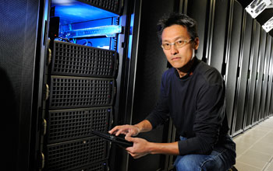
Wu Feng of Virginia Tech

Slide 11
NSF: More projects accepted in October
Discovery and Social Analytics for Large-Scale Scientific Literature
Rutgers, Cornell, Princeton Universities; 3 year proj, $1 million;
  investigating the individual and social patterns that relate to how text repositories are actually accessed and used
A Formal Foundation for Big Data Management, University of Washington; 3 year proj, $2 million; The results of this project will make it easier for domain experts to conduct complex data analysis on Big Data and on large computer clusters.
DataBridge - A Sociometric System for Long-Tail Science Data Collections, North Carolina, Harvard University, 3 year proj, $850000; DataBridge supports advances in science and engineering by directly enabling and improving discovery of relevant scientific data across large, distributed and diverse collections using socio-metric networks.

Slide 12
NIST Reaction to White House Initiative
NIST has held a Big Data Workshop [1] 13-14 June 2012 in Gaithersburg to explore key national priority topics in support of the White House Big Data Initiative. The workshop was held in collaboration with the NSF sponsored Center for Hybrid Multicore Productivity Research, a collaboration between UMBC, Georgia Tech and UCSD.
This workshop discussed examples from science, health, disaster management, security, and finance as well as topics in emerging technology areas, including analytics and architectures. Two issues of special interest are identifying the core technologies needed to collect, store, preserve, manage, analyze, and share big data that could be standardized and developing measurements to ensure the accuracy and robustness of big data methods.
An agenda [4] is available
[1] http://www.nist.gov/itl/ssd/is/big-data.cfm
[2] http://www.whitehouse.gov/sites/default/files/microsites/ostp/big_data_press_release_final_2.pdf
[3] http://chmpr.umbc.edu/
[4] http://www.nist.gov/itl/ssd/is/upload/BIG-DATA-Workshop-may25.pdf

Slide 13
European programs related to Big Data
GRDI2020 – A 10 year vision for Global Research Data Infrastructures: The Big Data Challenges: the Research Data Infrastructure, must be developed for harnessing the accumulating data and knowledge produced by the communities of research.
ESFRI, the European Strategy Forum on Research Infrastructures, ESFRI 2010 roadmap is worth an investment of around €20b together with €2b/year for operating costs intended for strategic policies for pan-European Research Infrastructures
SIENA: Standards and Interoperability for eInfrastructure implemeNtation initiative, to support the analysis of open standards-based interoperable grid and cloud computing infrastructures.
VENUS-C: Virtual Multidisciplinary Environments Using Cloud Infrastructures - follows a centric approach to cloud computing by bringing together industrial partners and scientific user communities. Covers 10 thematic areas: biodiversity; chemistry; civil engineering and architecture; civil protection; earth sciences; social media; mathematics; mechanical, and aerospace engineering; healthcare; molecular, cellular and genetic biology; and astrophysics.

Slide 14
What Does “Big Data” Mean? (M. Stonebraker in blogs)
Big Data can mean one of four things:
Big volumes of data, but "small analytics”. SQL analytics (count, sum, max, min, and avg with an optional group_by) on large amounts of data. Solution: multi-petabyte data warehouses are running on "shared nothing" server farms or on Hive/Hadoop. Prediction: main challenge in this world to be 100% uptime, SQL vendors will all move to column stores.
Big analytics on big volumes of data. Data clustering, regressions, machine learning, etc. on very large amounts of data (statistical packages, linear algebra packages, custom code, etc.). Complex analytics will increase dramatically in importance as data mining and other complex tasks shifting away from the simple analytics in traditional business intelligence systems. The skill set of business analysts should be upgraded. They will need to become facile in statistical operations.
Big velocity. Applications like electronic trading, real-time and placement on Web pages, real-time customer targeting, and mobile social networking
Big variety. Integrating a larger and larger number of data sources with diverse data. Many enterprises view this as their number one headache. Historically, the extract, transform, and load (ETL) is used. Automatic discovery of structure, entity resolution, transformation is needed.

Slide 15
Big Data-related Application Areas (Examples)

Slide 16
Big Data-related Application Areas (Examples)
Social Sciences and Humanities
  Social Network Applications
  Crime and Corruption Observatory: Big Questions behind Big Data
Environmental Sciences
  Monitoring: Seismological Grand Challenges in Understanding the Earth’s Dynamic systemSeaDataNet – Pan-European infrastructure for ocean and marine data management
  Environmental (GRDI2020 Program)
  Grid Technologies for Satellite Data Processing and Management Within International Disaster Monitoring Projects
  Transparent Data Cube for Spatiotemporal Data Mining and Visualization (Russia)
  Data and Knowledge for Global Food Security
Biological and Medical Sciences
  EU-Brazil OpenBio – EU-Brazil Open Data and Cloud Computing e-Infra­structure for Biodiversity
  Managing and Analysing Genomic Data Using HPC and Clouds
  Distributed Storage of Large-Scale Multidimensional Electroencephalogram Data Using Hadoop and HBase
  Bio2RDF an open-source project that aims to facilitate biomedical knowledge discovery using Semantic Web technologies
  Science commons and neurocommons (knowledge management platform for biological research)
Materials
  Synthesis, atom by atom, of new forms of matter with tailored properties, including nano-scale objects
  Transformational discoveries for energy technologies
  QNano – A pan-European infrastructure for quality in nanomaterials safety testing

Slide 17
Big Data-related APPPLICATION Areas (Examples) (2)
Physical Sciences and Engineering
  SKA – Square Kilometre Array
  LHC – The Large Hadron Collider complex
  VAMDC – Virtual Atomic and Molecular Data
E-Infrastructures
  LinkSCEEM-2 – Linking Scientific Computing in Europe and the Eastern
  EUDAT – European Data Infrastructure
  Linked open data in sensor data mashups
  Sensor trajectory data processed by MapReduce
  BigData Application ecosystem
  Creating Knowledge out of Interlinked Data (LOD2)
  Future Internet-based Enterprise Systems
  Cloud Architectures to Enable Cross-Federation
  Co-clustering of Large and High Dimensional Data
  Data Service Architectures (Service-Enabling Data Stores, Cloud Data Services, Cloud data service integration, etc.)
  Large scientific data centers
  Open CirrusTM the HP/Intel/Yahoo! Open Cloud Computing Research Testbed
Energy
  RIEEB – Research Infrastructures for Energy Efficiency in Buildings

Slide 18
Big Data Platforms

Slide 19
Nine Big-Name Options for Big Data
1) Cloud-based options: Amazon offers Elastic Map Reduce (scalable Hadoop service), tools to help with analytics, DynamoDB, a NoSQL database.
2) Google cloud-based approach to Big Data: BigQuery — an analytical database — and the Prediction API, which is still an immature offering and has something to do with machine learning, according to Radar O’Reilly. Its cloud application hosting service, AppEngine, also offers a MapReduce facility.
3) HP acquired Big Data pure-play Vertica, a Big Data column-oriented analytics database, it offers a Hadoop connector.
4) Hortonworks is helping Microsoft develop its own Hadoop-based offering on Windows Azure, a third cloud-based option. Radar O’Reilly recently published a detailed look at Microsoft’s Big Data strategy. A purely open source Hadoop on Windows is planned.

Slide 20
Nine Big-Name Options for Big Data (2)
5) Oracle introduced its Big Data Appliance in January at the surprising low price point of $450,000 with 12 percent hardware and software maintenance, which works out to be $54,000. This solution uses the Cloudera distribution of Hadoop, plus Cloudera Manager and R + Exadata, Exalytics, Analytics, BI, Clouds in Oracle directory
6) SAP's approach to Big Data is to focus on integrating it with other tools. It offers SAP HANA for transactional data. For large data stores, like Hadoop, “SAP is entering this market through Sybase IQ, which has added significant Map-Reduce capabilities,” according to this Forbes article, which offers a very detailed assessment of SAP’s Big Data approach.
7) Teradata Aster comes in both the basic software platform and as an appliance. It includes both SQL and MapReduce analytic processing.
8) SAS is working on a solution that marries Hadoop Distributed File System (HDFS) with in-memory analytics
9) IBM InfoSphere: DB2 , Linux, Cloud , Hadoop (InfoSphere BigInsights); Hive, Oozie, Pig, Zookeeper, Avro, Flume, HBase, Lucene, NoSQL component, HBase, Home page, case study

Slide 21
Big Data Technologies Forecast

Slide 22
Gartner's Hype Cycle
Five distinct categories that occur in the emergence of any new technology:
Technology trigger. A breakthrough, public demonstration, product launch or other event that generates significant press and industry interest.
Peak of inflated expectations. a phase of overenthusiasm and unrealistic projections during which a flurry of publicized activity by technology leaders results in some successes but more failures as the technology is pushed to its limits. The only enterprises making money at this stage are conference organizers and magazine publishers.
Trough of disillusionment. The point at which the technology becomes unfashionable and the press abandons the topic, because the technology did not live up to its overinflated expectations.
Slope of enlightenment. Focused experimentation and solid hard work by an increasingly diverse range of organizations lead to a true understanding of the technology's applicability, risks and benefits. Commercial off-the-shelf methodologies and tools become available to ease the development process.
Plateau of productivity. The real-world benefits of the technology are demonstrated and accepted. Tools and methodologies are increasingly stable as they enter their second and third generation. The final height of the plateau varies according to whether the technology is broadly applicable or only benefits a niche market.
Notes:
Вброс технологии ; Пик раздутых ожиданий; Впадина разочарования; Скат (склон, уклон) просветления; Плато продуктивности

Slide 23
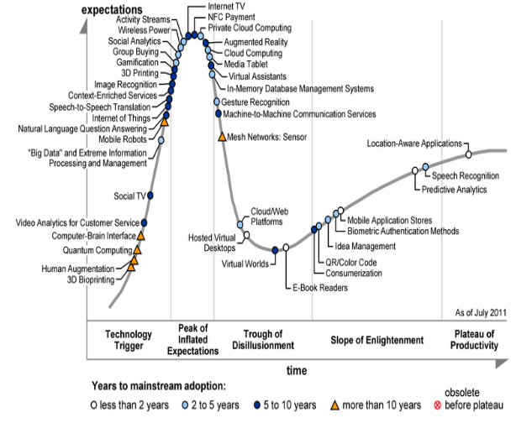
2011 Gartner Hype Cycle for Emerging Technologies
Notes:
Trough = впадина

Slide 24
Gartner’s Hype Cycle for Big Data
Prediction of the winning technologies in the immediate future:
Column-Store DBMS, Cloud Computing, In-Memory Database Management Systems will be the three most transformational technologies in the next five years.
Complex Event Processing, Content Analytics, Context-Enriched Services, Hybrid Cloud Computing, Information Capabilities Framework and Telematics round out the technologies the research firm considers transformational.
As experimentation increases, many technologies will slide into the “trough of disillusionment,” as MapReduce, text analytics, and in-memory data grids have already done.
Gartner says it doesn’t believe big-data will be a hyped term for too long. “Unlike other Hype Cycles, which are published year after year, we believe it is possible that within two to three years, the ability to address new sources and types, and increasing volumes of information will be ‘table stakes’ — part of the cost of entry of playing in the global economy”

Slide 25
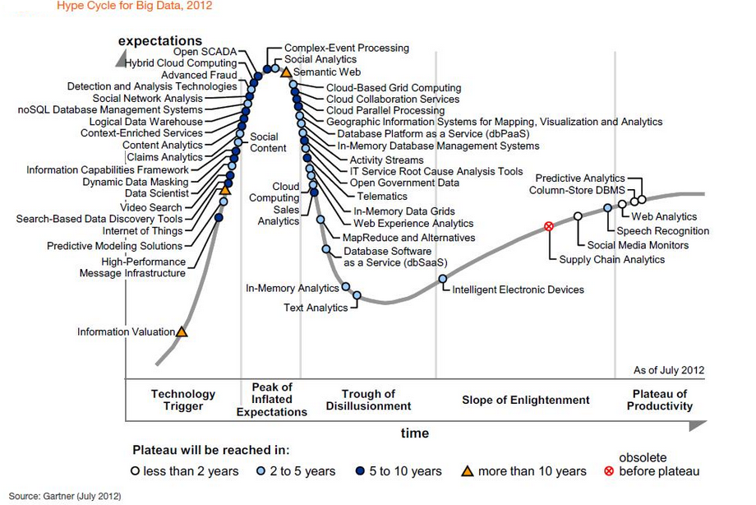

Slide 26
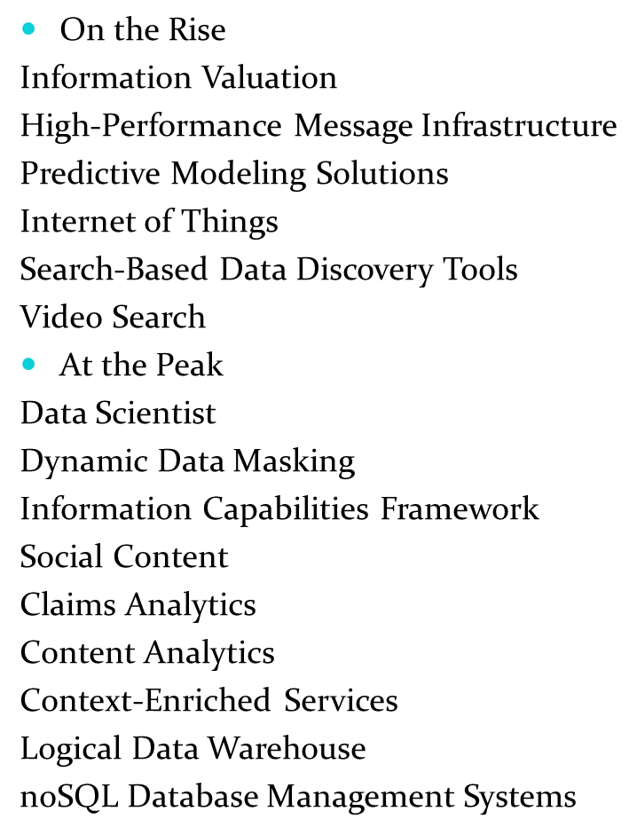
Big Data Technologies on the Hype Cycle (1)
Social Network Analysis
Advanced Fraud Detection and Analysis Technologies
Hybrid Cloud Computing
Open SCADA
Complex-Event Processing
Social Analytics
Semantic Web
Cloud-Based Grid Computing
Cloud Collaboration Services
Cloud Parallel Processing
Geographic Information Systems for Mapping, Visualization and Analytics
Database Platform as a Service (dbPaaS)
In-Memory Database Management Systems
Activity Streams
IT Service Root Cause Analysis Tools
Open Government Data

Slide 27
Big Data Technologies on the Hype Cycle (2)
Sliding Into the Trough
Telematics
In-Memory Data Grids
Web Experience Analytics
Cloud Computing
Sales Analytics
MapReduce and Alternatives
Database Software as a Service (dbSaaS)
In-Memory Analytics
Text Analytics
Climbing the Slope
Intelligent Electronic Devices
Supply Chain Analytics
Social Media Monitors
Speech Recognition
Entering the Plateau
Web Analytics
Column-Store DBMS
Predictive Analytics

Slide 28
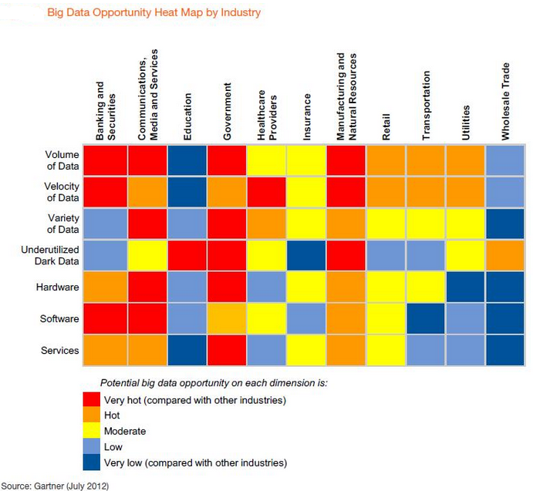
Notes:
A heat map (тепловая карта) is any data visualization which uses color to represent data values in a two-dimensional image. There are many different types of heat maps used in different disciplines, each referred to by the term "heat map", even though they use different visualization techniques.
http://www.labescape.com/info/index.html#articles

Slide 29
Fundamental Big Data Challenge:
D2K (Data-to-Knowledge)
4th paradigm of science (which is the emerging data-oriented approach to any discipline X) is different from Experiment, Theory, and Computational Modeling.
A complete data collection on a domain (e.g., the Earth, or the Universe, or the Human Body) encodes the knowledge of that domain (the data becomes the model), waiting to be mined and discovered
This is called “X-Informatics”: addressing the D2K (Data-to-Knowledge) Challenge in any discipline X using Data Science.
  Examples: Bioinformatics, Geoinformatics, Astroinformatics, Climate Informatics, Ecological Informatics, Biodiversity Informatics, Environmental Informatics, Health Informatics, Medical Informatics, Neuroinformatics, Crystal Informatics, Cheminformatics, Discovery Informatics, and more …

Slide 30
THANK YOU

